Slide 1

DFDG: Federated GNNs Learning from Dynamic Graphs for Traffic Forecasting.
Muhammad Usman

Slide 2

Objectives
Outcomes
Motivation [problem]
Data Source
Methodology
Preliminary Analysis
Roadmap – Further Plaining
Real Time application Design

Slide 3

Problem Statement and Motivation
Advanced forecasting of traffic speed using previously observed traffic flow. By applying the Federated GNN Learning
Why is it important, applications?
Emergency Response Planning
Traffic Management Optimization
Efficient Resource Utilization
Smart City Development
Economic Benefits

Slide 4
Data Sources
METR_LA
PEMS_Bay
PEMS_D7M
EXPY-TKY

Slide 5
More about First two datasets
Metr_LA : A traffic forecasting dataset based on Los Angeles metropolitan traffic conditions. The dataset contains traffic readings collected from 207 loop detectors on highways in Los Angeles county in aggregated 5-minute intervals for 4 months between March 2012 to June 2012.
PEMS-BAY: This traffic dataset is collected by California transportation agencies (Caltrans) performance measurement system (PEMS). It is represented by a network of 325 traffic sensors in the bay area with 6 months of traffic readings ranging from Jan 1st 2017 to may 31th 2017 in 5 minute intervals.

Slide 6

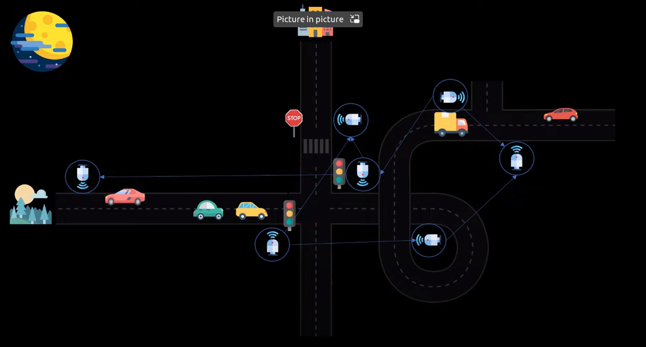
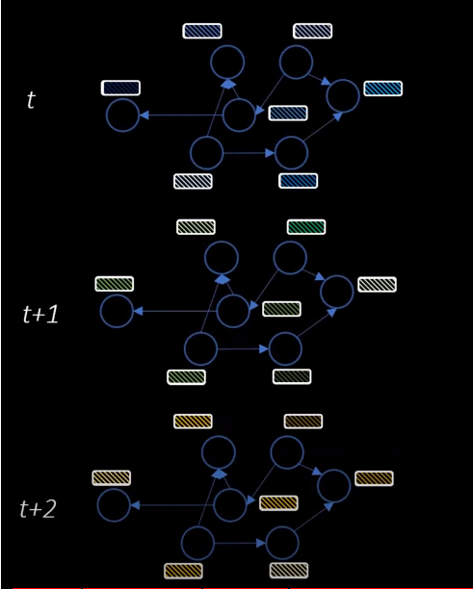
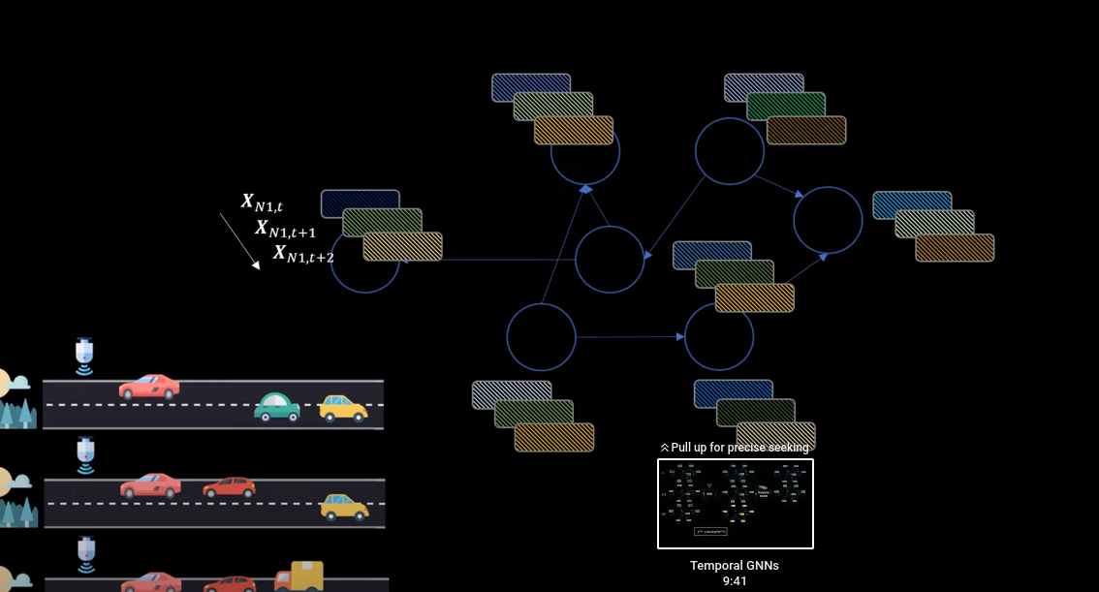
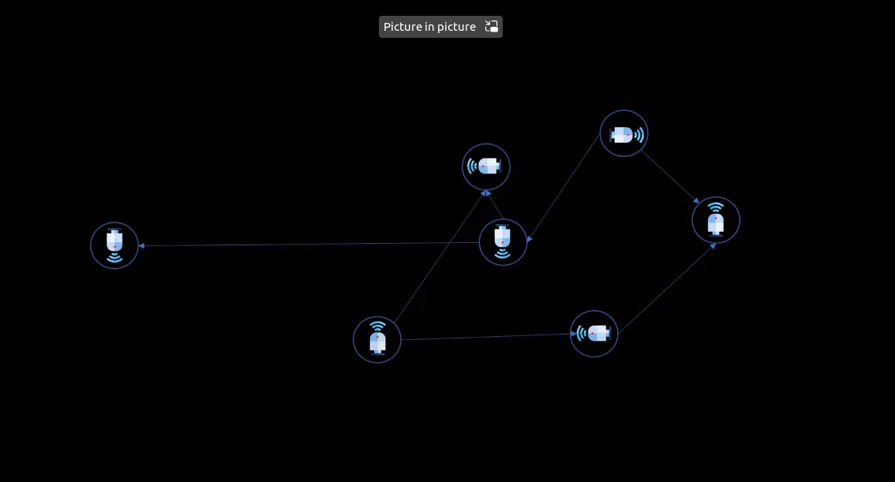
How the Metr_LA Dataset is constructed.

Slide 7
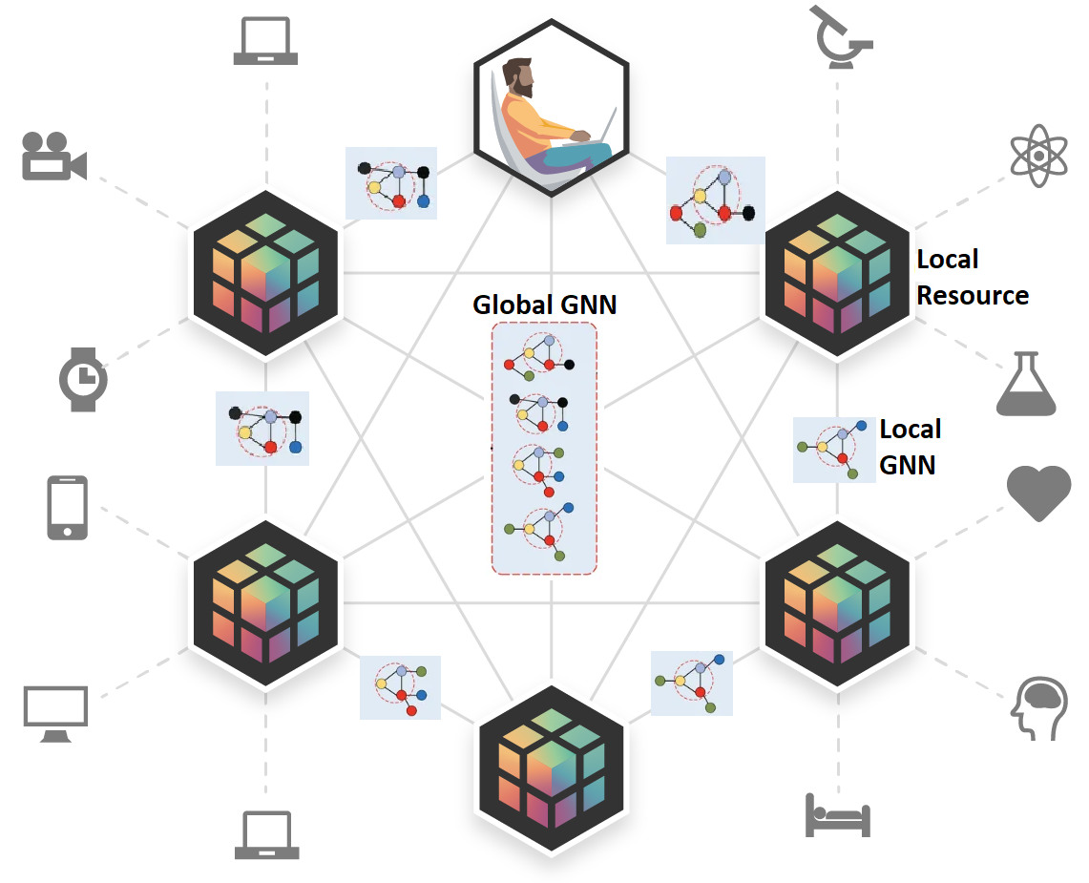
Federated GNNs Learning

Slide 8
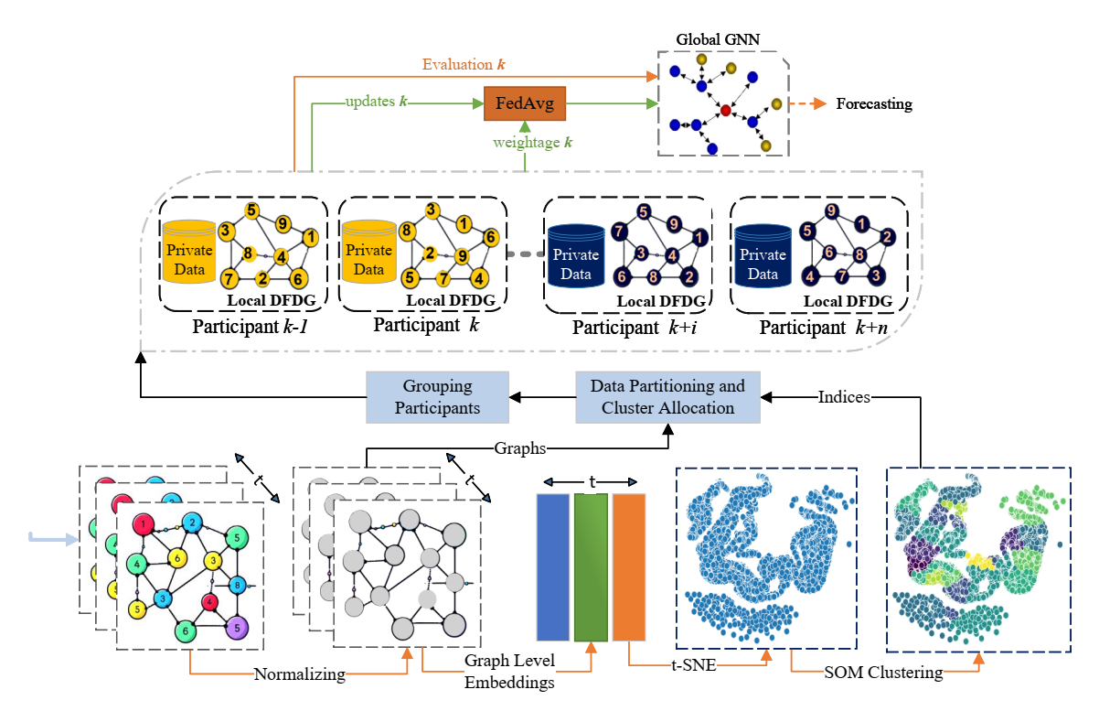
The Methodology

Slide 9
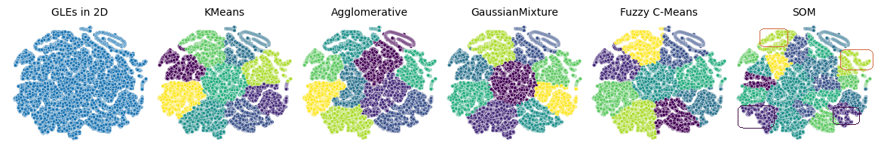
The Methodology

Slide 10
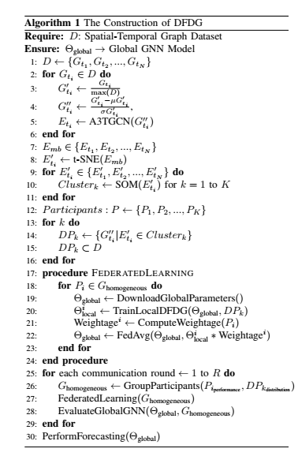
DFDG Algorithm.

Slide 11
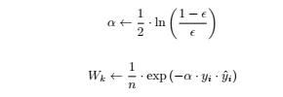
Weightage Wk

Slide 12
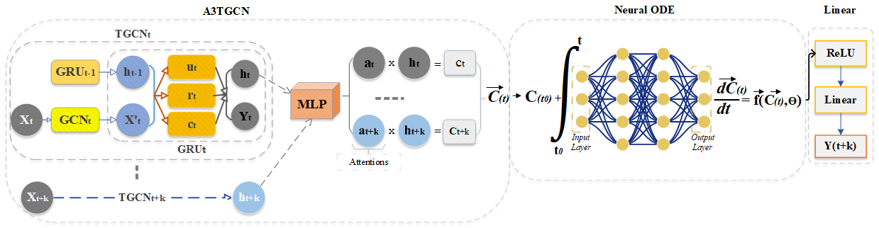
Participant’s Local Model Architecture
Notes:
GRU: Capture the dynamic changes of node properties to obtain local temporal trends of traffic status. HT-1 is the hidden state of T-1
Xt is the speed of traffic at the current moment
RT is a reset gate that controls how much status information is ignored in the previous moment
UT is an update gate that controls the amount of state information at the moment before entering the current state.
ct is the memory content stored at the current moment
ht is the output state at the current moment.

Slide 13
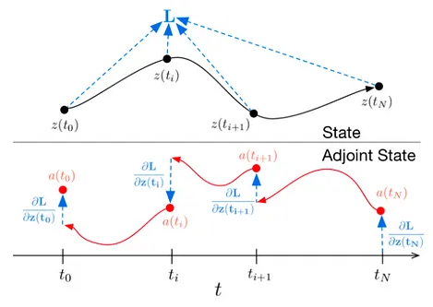
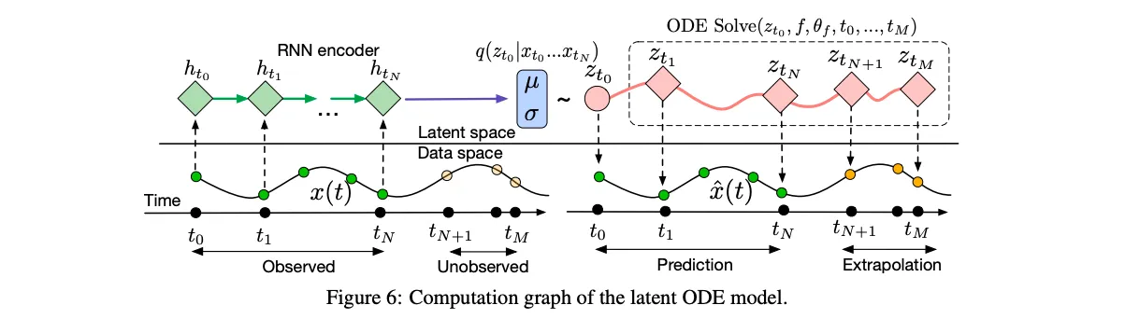
How Neural ODEs Works

Slide 14
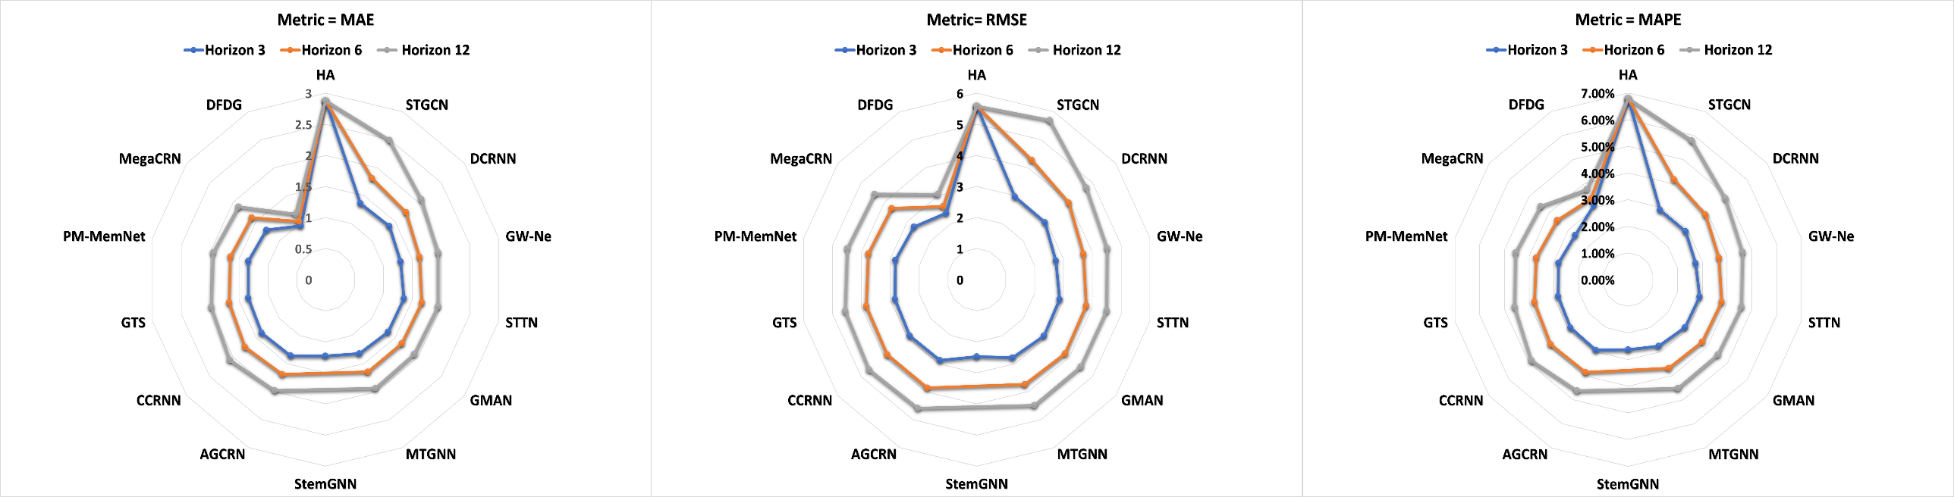
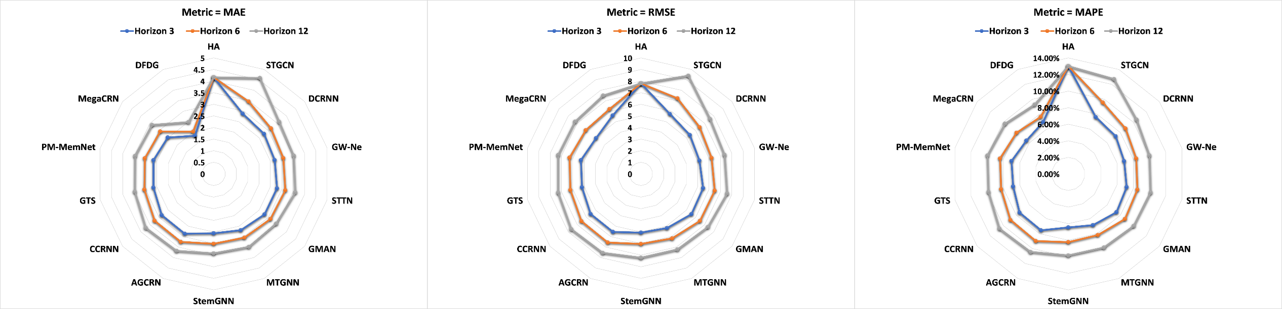
Visualizing the Performance of Various Methods on Pems-Bay
Visualizing the Performance of Various Methods on Metr-LA

Slide 15
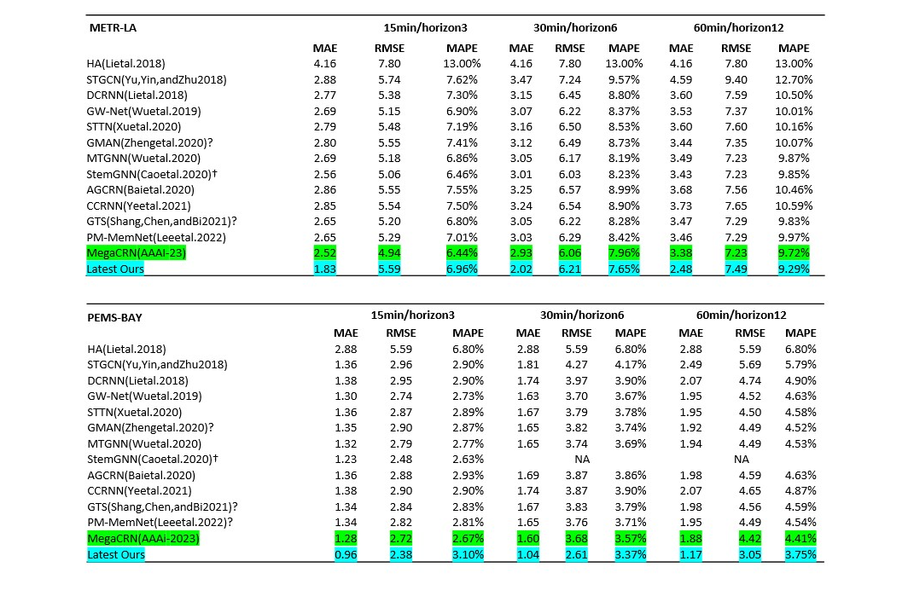
Model Performance Measurements

Slide 16
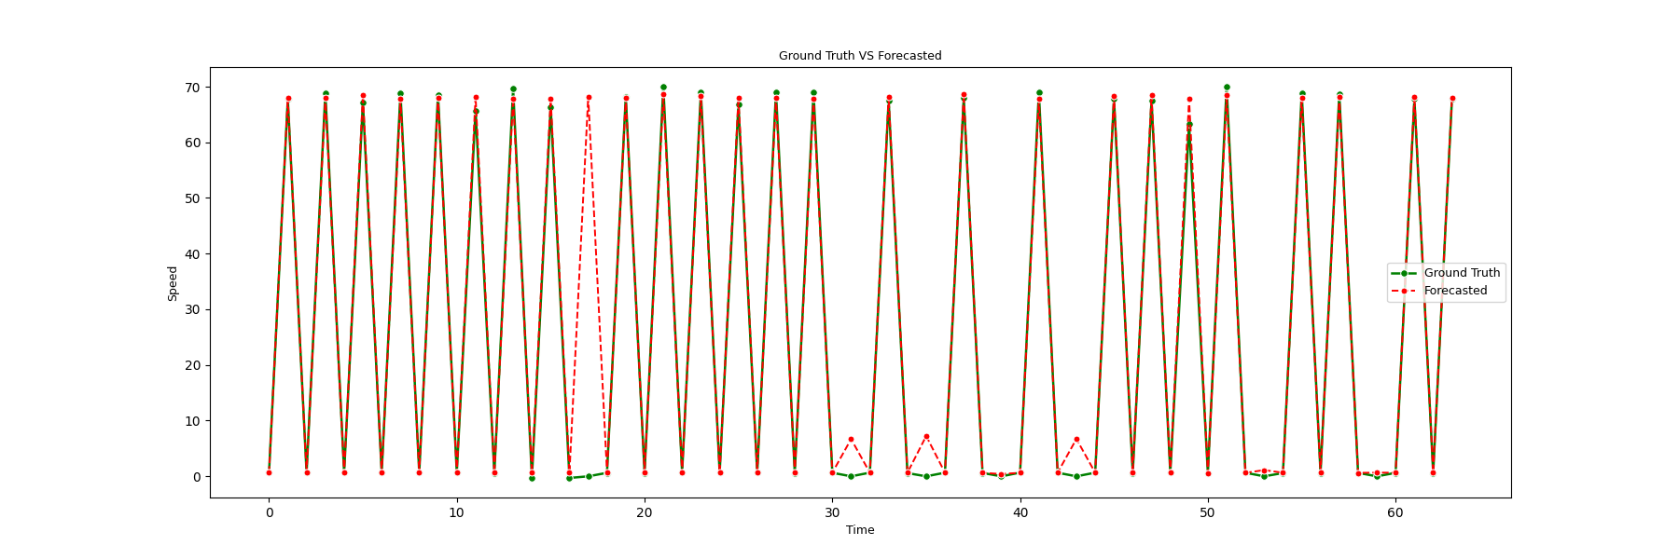
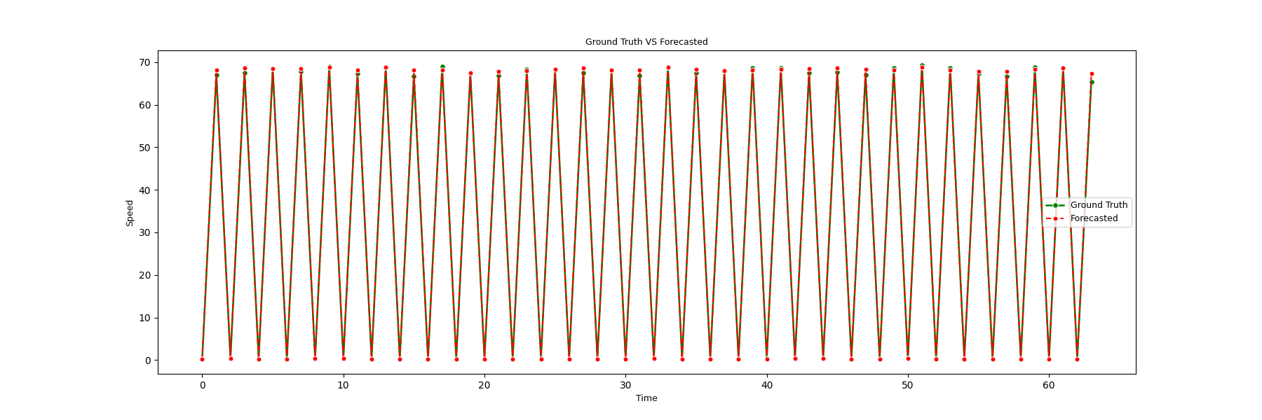
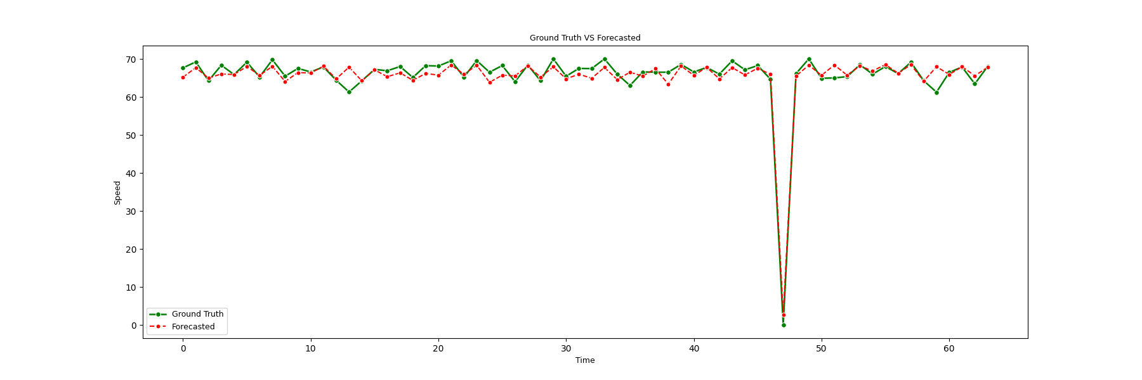
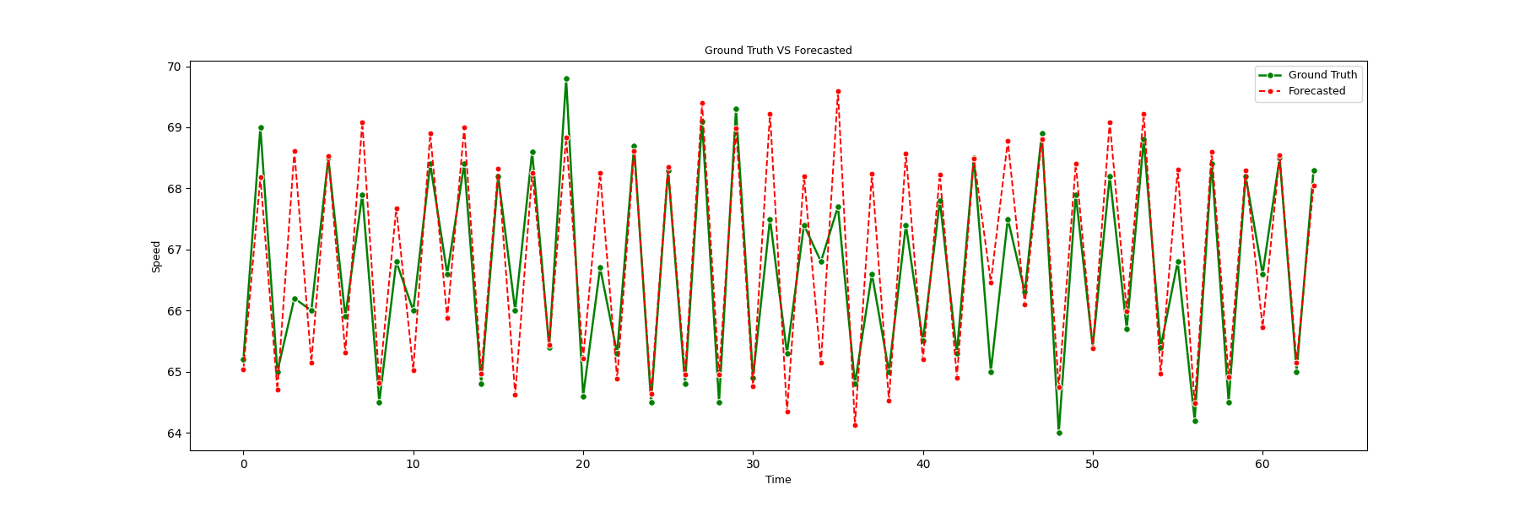
Forecasted Results
METR LA: 15minutes Forecasting
PEMS_Bay: 15minutes Forecasting
METR LA: 30 minutes Forecasting
PEMS_Bay: 30minutes Forecasting

Slide 17
Limitations
Computational expensive, especially sharing parameters.
Requires careful management of training and testing, otherwise will.
A complex structure.

Slide 18
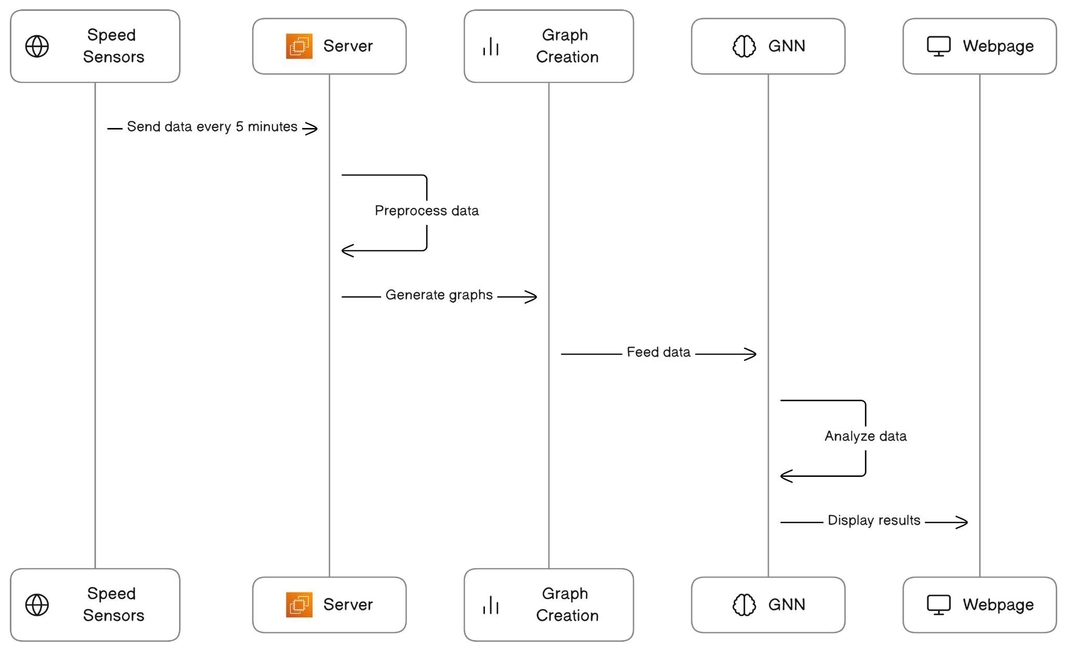
Real-time Application Design

Slide 19
Planning
Cross-validation on
PEMS_D7M
EXPY-TKY

Slide 20
Outcomes
A reputed publication.
And a Real-life test, in case the required resource(sensors) are provided.

